Slide 1
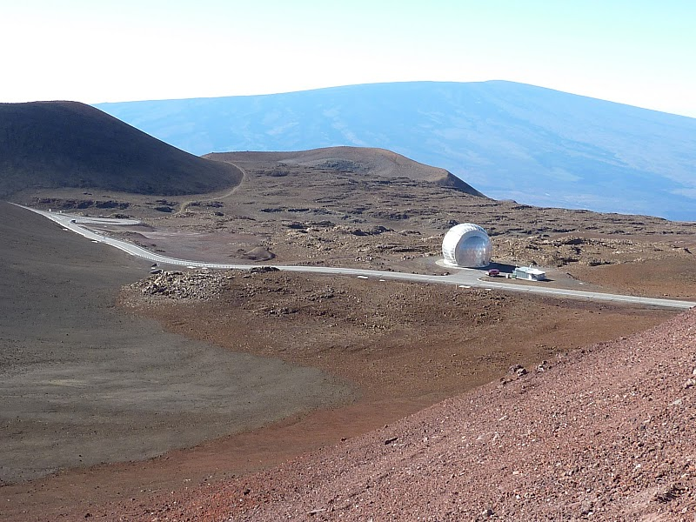



Compositional and Microtextural Analysis of
Basaltic Pyroclastic Feedstock Materials
Used for the 2010 ISRU Field Tests,
Mauna Kea, Hawaii
N. Marin, J. Farmer, K. Zacny, G. Sellar, J. Nuñez
School of Earth and Space Exploration

Slide 2

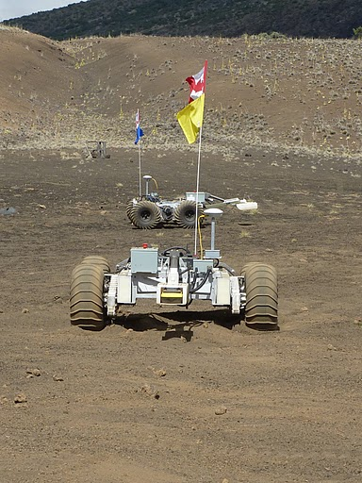
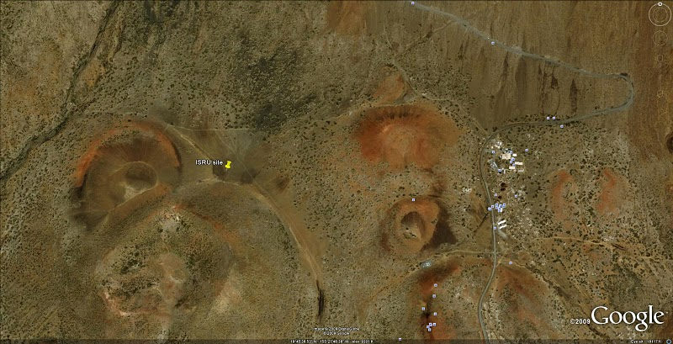
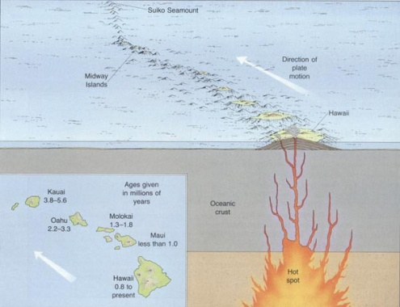
ISRU: In Situ Resource
Utilization
Goal: extract basic resources from basalt
Ex: water, oxygen, methane
NASA-sponsored ISRU experiments were
carried out in February of 2010 on the slopes of
Mauna Kea Volcano, Hawaii
WHY?: to support future human exploration
of the moon

Slide 3
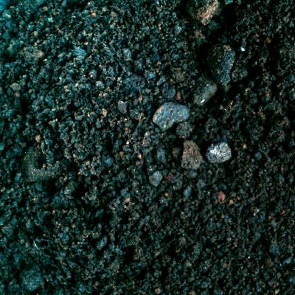
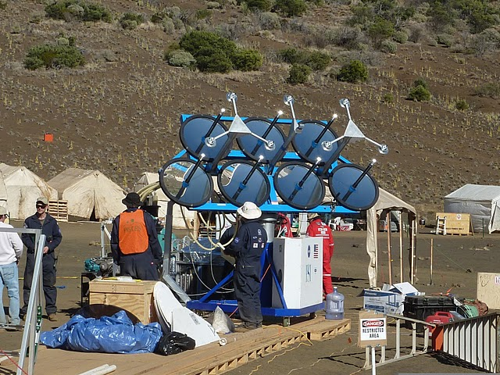

FeO + H₂ → Fe + H₂O

Slide 4

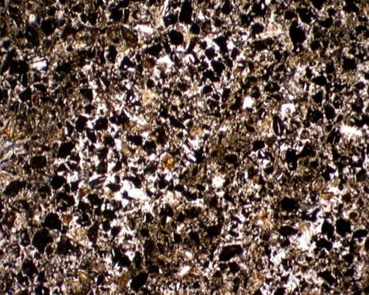
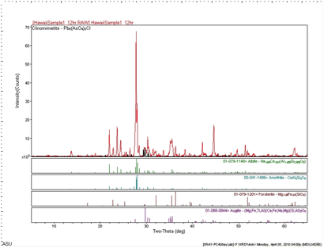
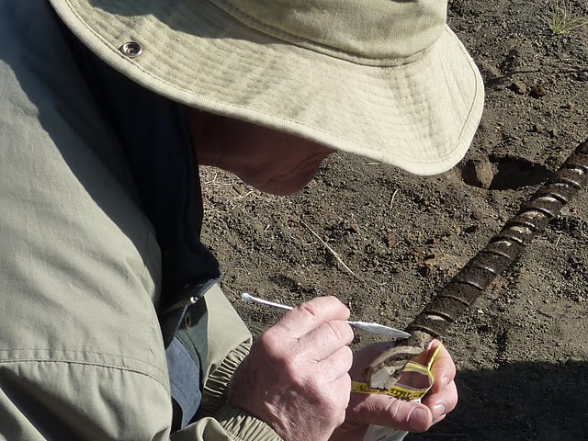
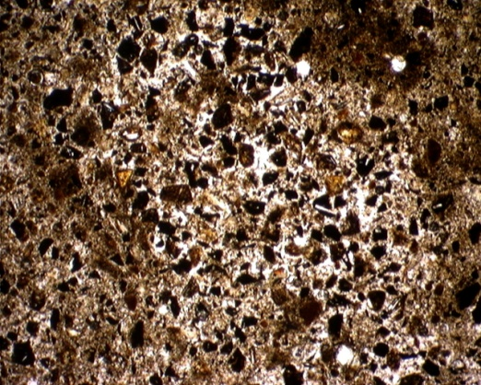
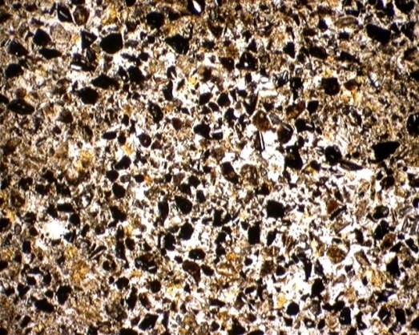
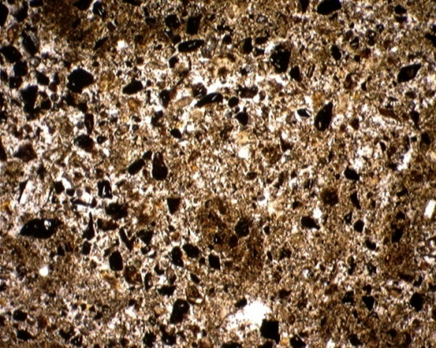
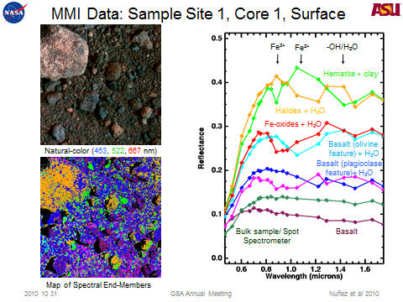
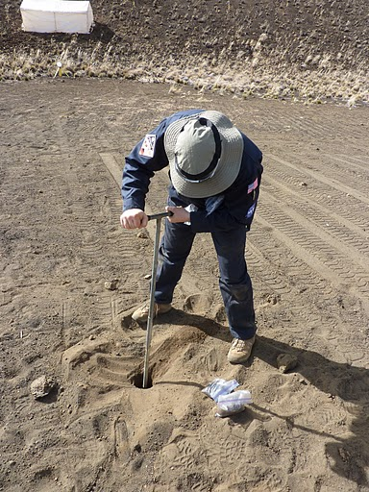
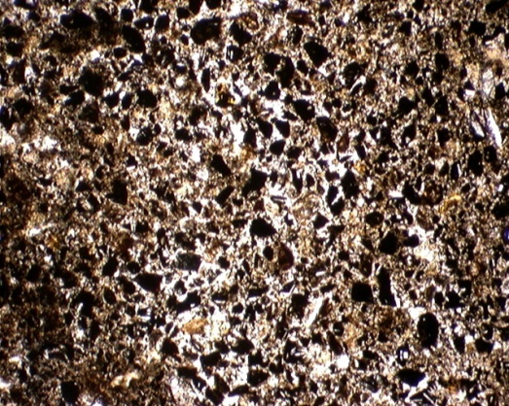
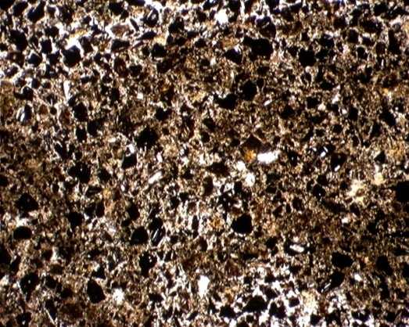
0 cm
(Sample 1)
~16.7 cm
(Sample 2)
~33.3 cm
(Sample 3)
~50 cm
(Sample 4)
~66.7 cm
(Sample 5)
~83.3 cm
(Sample 6)
1 m

Slide 5
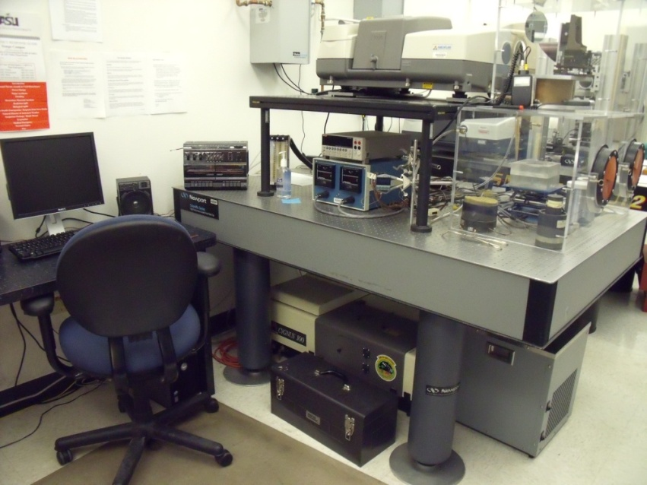
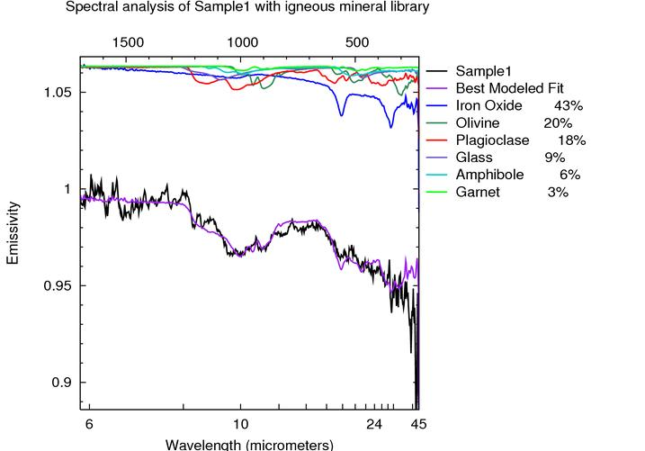
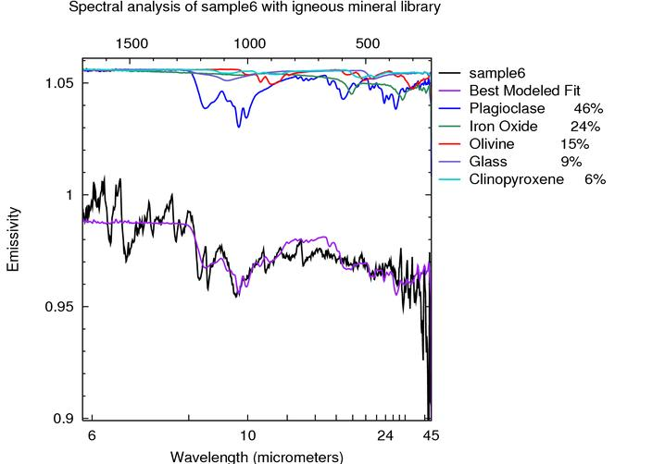
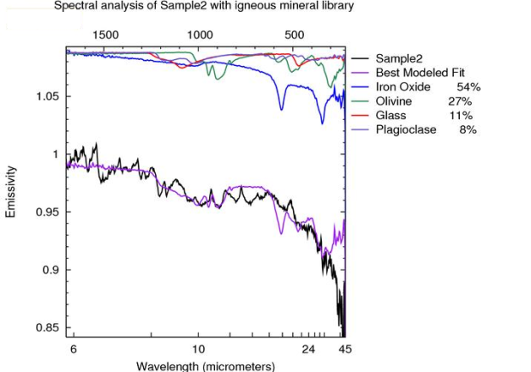
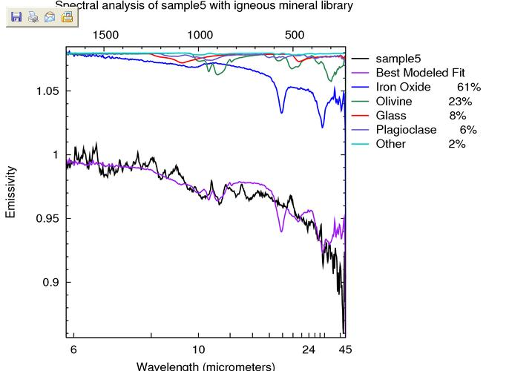
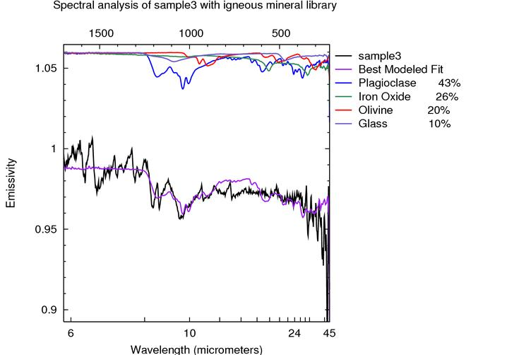
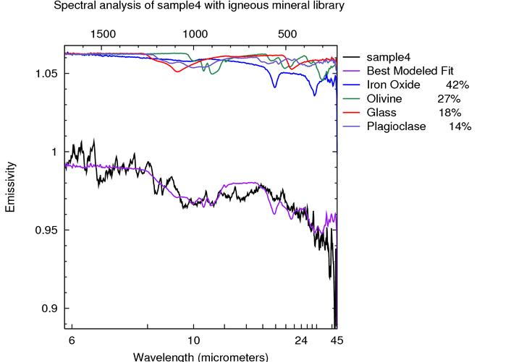
TIR (Thermal Infrared Spectroscopy):
-Iron Oxide
-Volcanic glass
-Plagioclase
-Olivine
-Pyroxene

Slide 6
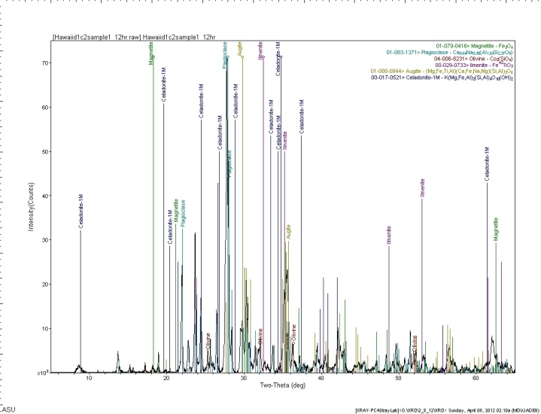
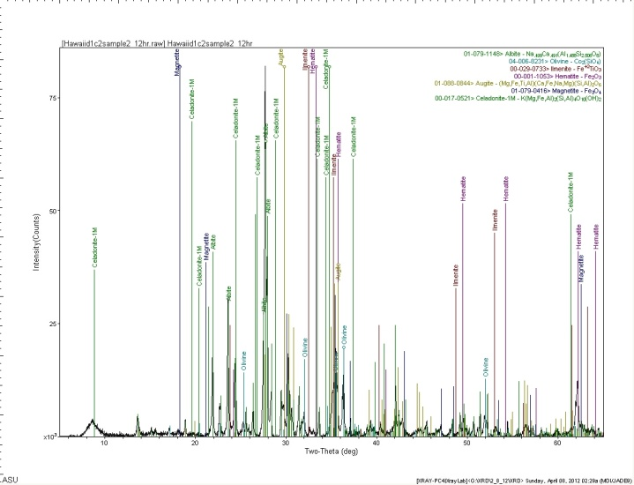
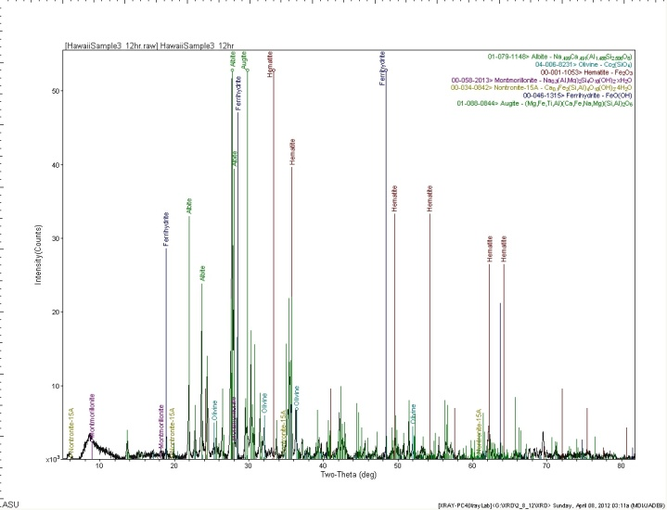
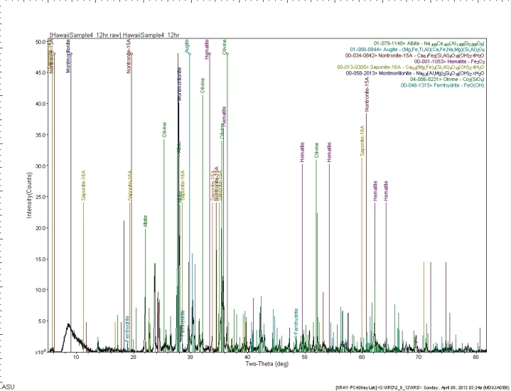
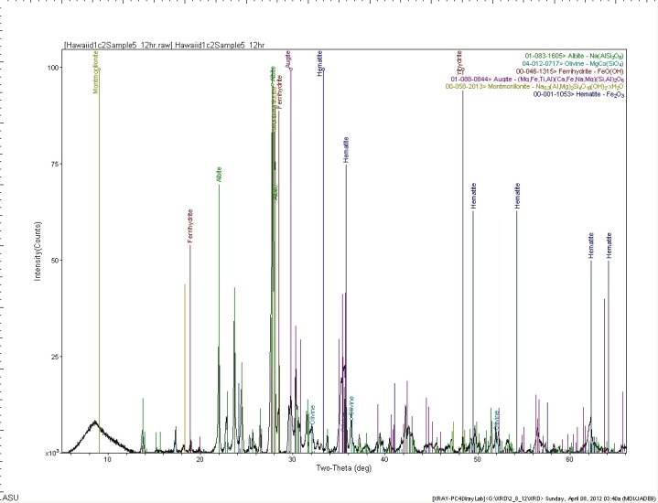
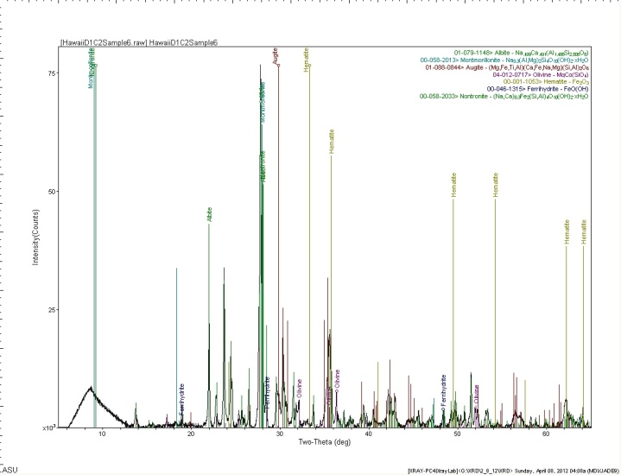
XRD Diffractograms

Slide 7

XRD Result Summary
 | 1 (sample) | 2 | 3 | 4 | 5 | 6
Plagioclase
Pyroxene
Olivine
Magnetite
Ilmenite
Hematite
Ferrihydrite
Celadonite
Nontronite
Montmoril.
Saponite

Slide 8
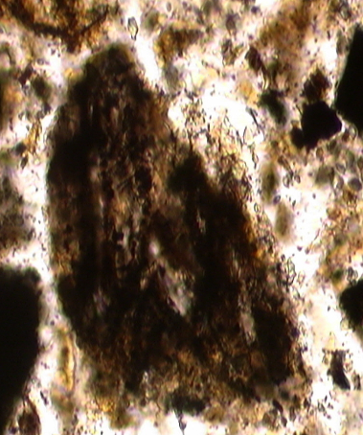
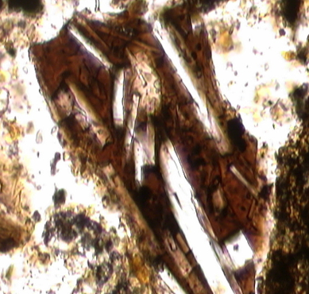
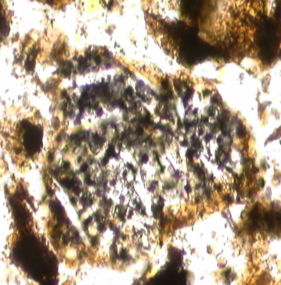
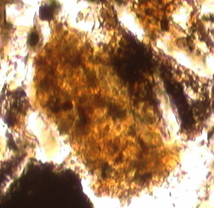
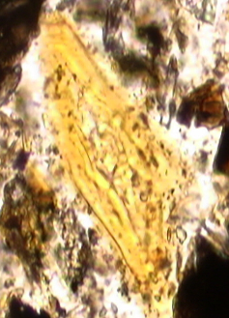
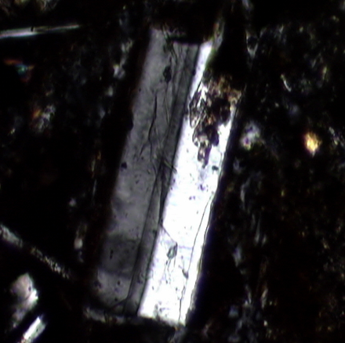
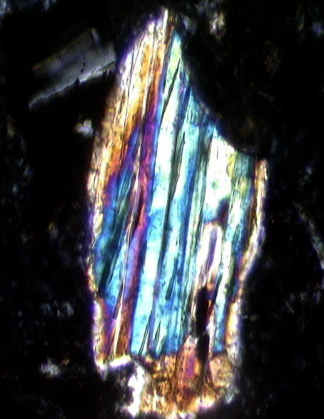
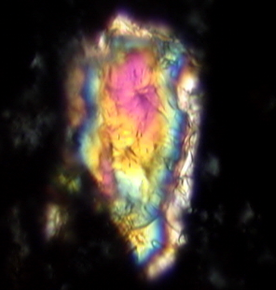
Dark Glass
Dark Glass with
Plagioclase
Glassy Porphyritic
Basalt (surface altered)
Microporphyritic
Basalt (interior altered)
Light Glass
Plagioclase
Pyroxene
Olivine

Slide 10
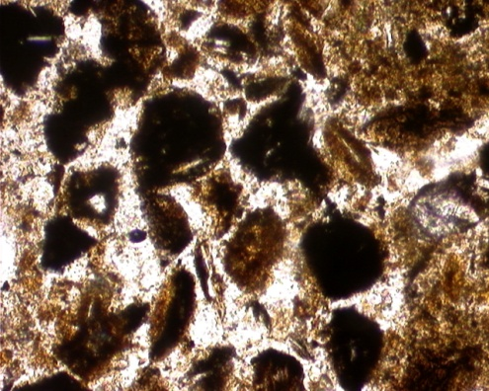

Image J

Slide 11
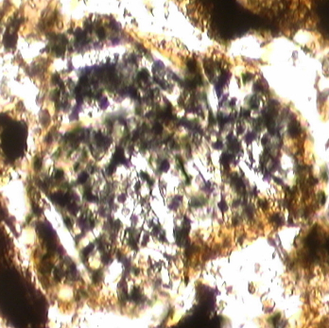
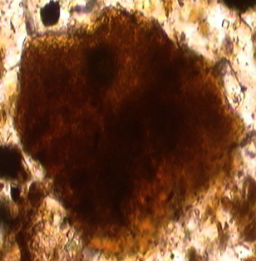
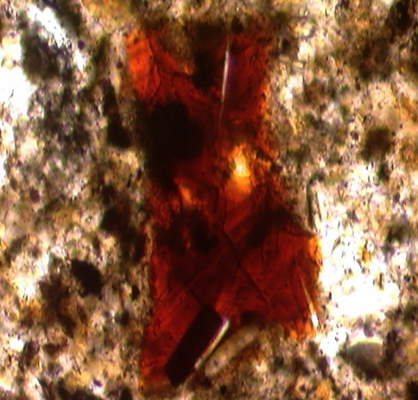
Conclusions
The amount of Fe³⁺ phases in the core samples increases with depth (age)
due to the weathering oxidation reactions caused by greater water exposure.
In comparison, the surface materials contain more Fe²⁺ phases, along with
unaltered porphyritic clasts. By the basic two step extraction process
proposed for ISRU, FeO + H₂ → Fe + H₂O (Allen et al. 1996), the observed
increase in the abundance of hydrated alteration phases with depth implies
that these deeper subsurface materials in Hawaii are more favorable for
not only the extraction of water from regolith, but also the extraction of
oxygen (e.g. 2FeOH + H₂ → 2Fe + 2 H₂ O).

